Slide 1
Language Modeling
Introduction to N-­‐grams

Slide 2
Probabilistic Language Models
Dan Jurafsky
Today’s goal: assign a probability to a sentence
Machine Translation:
P(high winds tonite) > P(large winds tonite)
Spell Correction
Why?
The office is about fifteen minuets from my house
P(about fifteen minutes from) > P(about fifteen minuets from)
Speech Recognition
P(I saw a van) >> P(eyes awe of an)
• + Summarization, question-­‐answering, etc., etc.!!

Slide 3
Probabilistic Language Modeling
Dan Jurafsky
Goal: compute the probability of a sentence or sequence of words:
P(W) = P(w₁,w₂,w₃,w₄,w₅…w_{n})
Related task: probability of an upcoming word:
P(w₅|w₁,w₂,w₃,w₄)
A model that computes either of these:
P(W) or P(w_{n}|w₁,w₂…w_{n-­‐1})
is called a language model.
Better: the grammar
But language model or LM is standard

Slide 4
How to compute P(W)
Dan Jurafsky
How to compute this joint probability:
P(its, water, is, so, transparent, that)
Intuition: let’s rely on the Chain Rule of Probability

Slide 5
Reminder: The Chain Rule
Dan Jurafsky
Recall the definition of conditional probabilities
Rewriting:
More variables:
P(A,B,C,D) = P(A)P(B|A)P(C|A,B)P(D|A,B,C)
The Chain Rule in General
P(x₁,x₂,x₃,…,x_{n}) = P(x₁)P(x₂|x₁)P(x₃|x₁,x₂)…P(x_{n}|x₁,…,x_{n-­‐1})

Slide 6
The Chain Rule applied to compute joint probability of words in sentence
Dan Jurafsky
P(w₁w₂ …w_{n} ) = ∏P(w_{i} | w₁w₂ …w_{i−1})
i
P(“its water is so transparent”) =
P(its) × P(water|its) × P(is|its water)
× P(so|its water is) × P(transparent|its water is so)

Slide 7
How to estimate these probabilities
Dan Jurafsky
Could we just count and divide?
P(the | its water is so transparent that) =
Count(its water is so transparent that the)
Count(its water is so transparent that)
No! Too many possible sentences!
We’ll never see enough data for estimating these

Slide 8
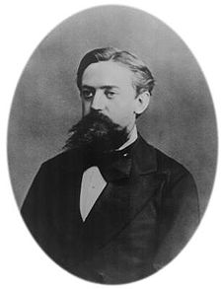
Markov Assumption
Dan Jurafsky
Simplifying assumption:
Andrei Markov
P(the | its water is so transparent that) P(the | that)
Or maybe
P(the | its water is so transparent that) P(the | transparent that)
Notes:
The assumption that the probability of a word depends only on the previous word.

Slide 9
P(w₁w₂ …w_{n} ) ∏ P(w_{i} | w_{i− k} …w_{i−1})
Dan Jurafsky
Markov Assumption
i
In other words, we approximate each component in the product
P(w_{i} | w₁w₂ …w_{i−1})
P(w_{i} | w_{i− k} …w_{i−1})

Slide 10
Simplest case: Unigram model
P(w₁w₂ …w_{n} ) ″ ∏P(w_{i} )
Dan Jurafsky
i
Some automatically generated sentences from a unigram model
fifth, an, of, futures, the, an, incorporated, a, a, the, inflation, most, dollars, quarter, in, is, mass
thrift, did, eighty, said, hard, 'm, july, bullish that, or, limited, the
Notes:
No context
P(l,live,lahore)= P(I), P(live), P(lahore)
MLE: P’(w1)=count(w1)/N(num of tokens)

Slide 11
Bigram model
Dan Jurafsky
Condition on the previous word:
P(w_{i} | w₁w₂ …w_{i−1}) # P(w_{i} | w_{i−1})
texaco, rose, one, in, this, issue, is, pursuing, growth, in, a, boiler, house, said, mr., gurria, mexico, 's, motion, control, proposal, without, permission, from, five, hundred, fifty, five, yen
outside, new, car, parking, lot, of, the, agreement, reached this, would, be, a, record, November
P(w4|w3)=count(w3,w4)/count w3
Notes:
Prob of a word depends on only the previous word
I live in lahore
P(lahore | in )= count(Lahore in)/count(in)

Slide 12
N-­‐gram models
Dan Jurafsky
We can extend to trigrams, 4-­‐grams, 5-­‐grams
In general this is an insufficient model of language
because language has long-­‐distance dependencies:
“The computer which I had just put into the machine room on the fifth ﬂoor crashed.”
But we can often get away with N-­‐gram models
Notes:
Context is n-1

Slide 13
Language Modeling
Introduction to N-­‐grams

Slide 14
Language Modeling
Estimating N-­‐gram Probabilities

Slide 15
Estimating bigram probabilities
Dan Jurafsky
The Maximum Likelihood Estimate
₎ ₌ count(w_{i−1},w_{i} )
P(w | w
i
i−1
count(w )
i−1
P'(i) =
count (i)
N
Notes:
MLE: ratio of counts in the probability: simply count the occurrence of word patterns to calculate the maximum likelihood estimation
N is the number of tokens

Slide 16
An example
Dan Jurafsky
<s> I am Sam </s>
<s> Sam I am </s>
<s> I do not like green eggs and ham </s>
c(w_{i-1},w_{i} )
P(w | w ) =
i
i−1
c(w )
i−1
Notes:
Assume uve atraining corpus and uve to compute bigram prob considering this corpus.
P(i | <S>)= count(<s>, I)/count <s>=2/3
How can we make sure that we have computed the prob of all words? Make a matrix

Slide 17
More examples:
Berkeley Restaurant Project sentences
Dan Jurafsky
can you tell me about any good cantonese restaurants close by
mid priced thai food is what i’m looking for
tell me about chez panisse
can you give me a listing of the kinds of food that are available
i’m looking for a good place to eat breakfast
when is caﬀe venezia open during the day

Slide 18
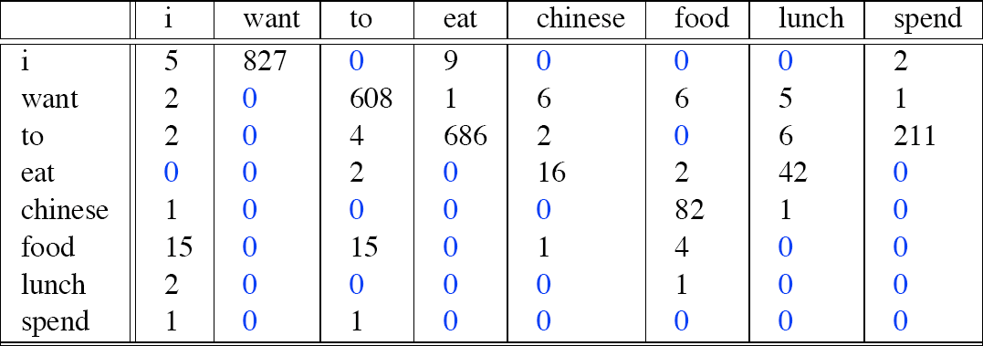
Raw bigram counts
Dan Jurafsky
Out of 9222 sentences
Notes:
Make a matrix of term to term, unique terms
2. also calculate frequency of each term individually as well
Make a matrix of unique terms
i k bd want kitni baar aya? This is what each term to term represents
It represents bigram, the count represents the frerquency of term to term

Slide 19
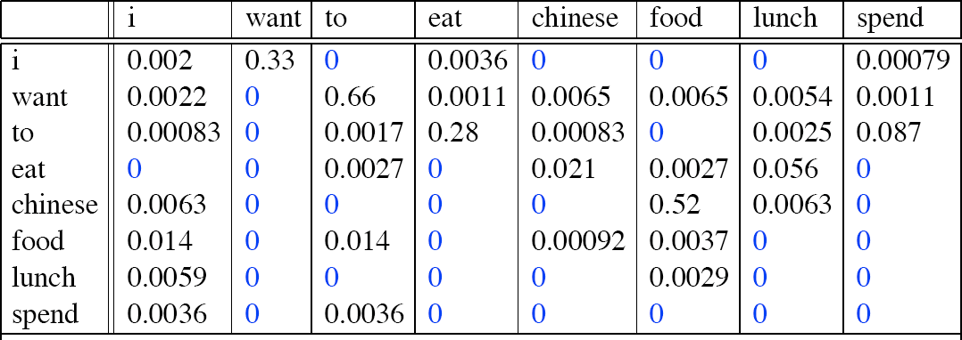
Raw bigram probabilities
Dan Jurafsky
Normalize by unigrams:
Result:
Notes:
P(i)= count (I)/ total count of i = 5/2533=0.002
P(want| I )= count (I want)/Count ( I )= 827/2533
Now if u have to compute probab of a sentence “<s>sam I do </s>”

Slide 20
Bigram estimates of sentence probabilities
Dan Jurafsky
P(<s> I want english food </s>) = P(I|<s>)
× P(want|I)
× P(english|want)
× P(food|english)
× P(</s>|food)
= .000031
Notes:
P(I|<s>)

Slide 21
What kinds of knowledge?
Dan Jurafsky
P(english|want) = .0011
P(chinese|want) = .0065
P(to|want) = .66
P(eat | to) = .28
P(food | to) = 0
P(want | spend) = 0
P (i | <s>) = .25

Slide 22
Practical Issues
Dan Jurafsky
We do everything in log space
Avoid underﬂow
(also adding is faster than multiplying)
log( p₁ × p₂ × p₃ × p₄ ) = log p₁ + log p₂ + log p₃ + log p₄

Slide 23
Language Modeling Toolkits
Dan Jurafsky
SRILM
http://www.speech.sri.com/projects/srilm/

Slide 24

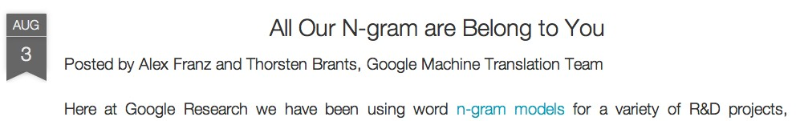
Google N-­‐Gram Release, August 2006
Dan Jurafsky
…

Slide 25
Google N-­‐Gram Release
Dan Jurafsky
serve
serve
serve
serve
serve
serve
serve
serve
serve
serve
as the incoming 92 as the incubator 99
as the independent 794 as the index 223
as the indication 72 as the indicator 120 as the indicators 45
as the indispensable 111 as the indispensible 40 as the individual 234
http://googleresearch.blogspot.com/2006/08/all-our-n-gram-are-belong-to-you.html

Slide 26
Google Book N-­‐grams
Dan Jurafsky
http://ngrams.googlelabs.com/

Slide 27
Language Modeling
Estimating N-­‐gram Probabilities

Slide 28
Language Modeling
Evaluation and Perplexity

Slide 29
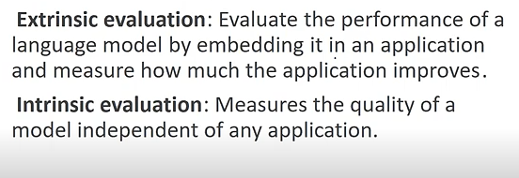
Types of Evaluation
Dan Jurafsky
Notes:
Extrinsic: compare diff models
Change technique and evaluate the task to identify performance
Intrinsic: training /testing corpus, evaluation metrics
Extrinsic Evaluation:
Definition: This refers to evaluating a model's performance in a real-world, practical application or task. In the context of N-gram language models, it could involve assessing how well the model performs in an actual language-related task, such as machine translation or speech recognition.
Challenges: The passage suggests that extrinsic evaluation is difficult and time-consuming. It may take days or weeks to complete, making it impractical for quick assessments.

Slide 30
Evaluation: How good is our model?
Dan Jurafsky
Does our language model prefer good sentences to bad ones?
Assign higher probability to “real” or “frequently observed” sentences
Than “ungrammatical” or “rarely observed” sentences?
We train parameters of our model on a training set.
We test the model’s performance on data we haven’t seen.
A test set is an unseen dataset that is diﬀerent from our training set, totally unused.
An evaluation metric tells us how well our model does on the test set.
Notes:
intrinsic

Slide 31
Extrinsic evaluation of N-­‐gram models
Dan Jurafsky
Best evaluation for comparing models A and B
Put each model in a task
spelling corrector, speech recognizer, MT system
Run the task, get an accuracy for A and for B
How many misspelled words corrected properly
How many words translated correctly
Compare accuracy for A and B
Notes:
Extrinsic Evaluation:
Definition: This refers to evaluating a model's performance in a real-world, practical application or task. In the context of N-gram language models, it could involve assessing how well the model performs in an actual language-related task, such as machine translation or speech recognition.
Challenges: The passage suggests that extrinsic evaluation is difficult and time-consuming. It may take days or weeks to complete, making it impractical for quick assessments.
Extrinsic: compare diff models
Change technique and evaluate the task to identify performance

Slide 32
Difficulty of extrinsic (in-­‐vivo) evaluation of N-­‐gram models
Dan Jurafsky
Extrinsic evaluation
Time-­‐consuming; can take days or weeks
So
Sometimes use intrinsic evaluation: perplexity
Bad approximation
unless the test data looks just like the training data
So generally only useful in pilot experiments
But is helpful to think about.
Notes:
Intrinsic: train-test
Intrinsic Evaluation - Perplexity:
Definition: Intrinsic evaluation involves assessing the model's performance based on its internal characteristics, without considering its application in a specific task. Perplexity is a common intrinsic metric used for language models. It measures how well the model predicts a sample of data.
Limitations: The passage notes that perplexity is a bad approximation of a model's real-world performance unless the test data closely resembles the training data. In other words, it may not accurately reflect how well the model generalizes to new, unseen data in practical scenarios.
Usefulness: Intrinsic evaluation, particularly through perplexity, is mentioned as generally only useful in pilot experiments. Pilot experiments are preliminary tests conducted to assess the feasibility of a study or experiment.

Slide 33
Intuition of Perplexity
Dan Jurafsky
mushrooms 0.1
pepperoni 0.1
anchovies 0.01
….
fried rice 0.0001
….
and 1e-100
The Shannon Game:
How well can we predict the next word?
I always order pizza with cheese and
The 33rd President of the US was
I saw a
Unigrams are terrible at this game. (Why?)
A better model of a text
is one which assigns a higher probability to the word that actually occurs
Notes:
Perplexity: The perplexity measures the amount of “randomness” in our model. If the perplexity is 3 (per word) then that means the model had a 1-in-3 chance of guessing (on average) the next word in the text. called the average branching factor
Unigram only stores the frequency of words
Still issues with unigram models...

Slide 34
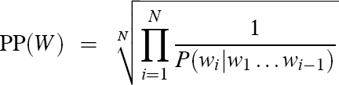
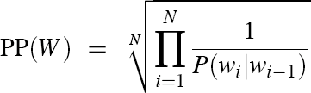
Perplexity
Dan Jurafsky
The best language model is one that best predicts an unseen test set
Gives the highest P(sentence)
Perplexity is the inverse probability of the test set, normalized by the number of words:
−
1
N
PP(W ) = P(w₁w₂...w_{N} )
1
= N
P(w w ...w )
1 2 N
Chain rule:
For bigrams:
Minimizing perplexity is the same as maximizing probability
Notes:
chain rule: P(sentence)=P(w4|w3 w2 w1) P(w3|w2 w1) P(w2|w1) P(w1)
Suppose a sentence with 10 words and each has a prob of occurring 10 times
PP=(((1/10)^10)^-1/10)
Perpexity: inverse under root of N

Slide 35
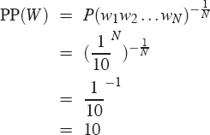
Perplexity as branching factor
Dan Jurafsky
Let’s suppose a sentence consisting of random digits
What is the perplexity of this sentence according to a model that assign P=1/10 to each digit?
Notes:
Suppose a sentence with 10 words and each has a prob of occurring 1/10 times
PP=(((1/10)^10)^-1/10)

Slide 36
The Shannon Game intuition for perplexity
Dan Jurafsky
From Josh Goodman
How hard is the task of recognizing digits ‘0,1,2,3,4,5,6,7,8,9’
Perplexity 10
How hard is recognizing (30,000) names at Microsoft.
Perplexity = 30,000
If a system has to recognize
Operator (1 in 4)
Sales (1 in 4)
Technical Support (1 in 4)
30,000 names (1 in 120,000 each)
Perplexity is 53
Perplexity is weighted equivalent branching factor
Notes:
PP is : Average branching factor
On avg how many dogits/charac can come next
If uve 10 possible words that can occur next and they all have equal probability then its PP be 10

Slide 37
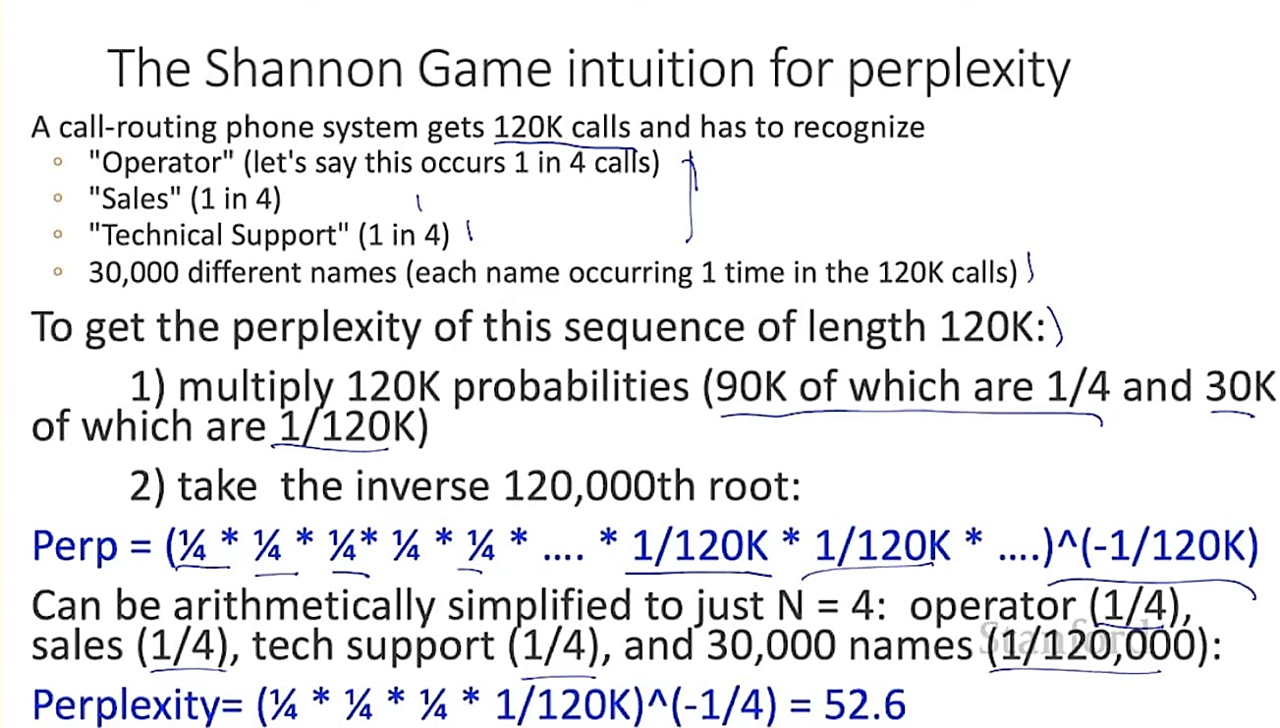

Slide 38
Lower perplexity = better model
Dan Jurafsky
Training 38 million words, test 1.5 million words, WSJ
N-­‐gram Order | Unigram | Bigram | Trigram
Perplexity | 962 | 170 | 109
Notes:
Calculated probabilities of all words and then their PP
How is trigram better then bigram? Because it covers more context but computation wise bcms expensive
Wall street journal (WSJ)

Slide 39
Language Modeling
Evaluation and Perplexity

Slide 40
Language Modeling
Generalization and zeros

Slide 41
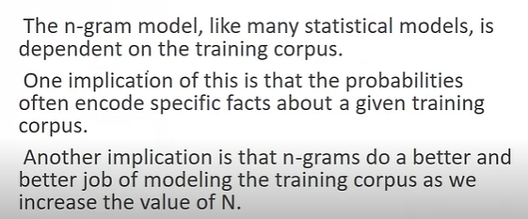
The Shannon Visualization Method
Dan Jurafsky

Slide 42
The Shannon Visualization Method
Dan Jurafsky
<s> I
I want
want to
to
Choose a random bigram
(<s>, w) according to its probability
Now choose a random bigram (w, x) according to its probability
And so on until we choose </s>
Then string the words together
eat
eat Chinese
Chinese
food food
</s>
I want to eat Chinese food
Notes:
If uve trained bigram model on a restruant data. if u generate data from that model it will generate data according to that trained data, that is it cannot generate sentences related to medicine.

Slide 43
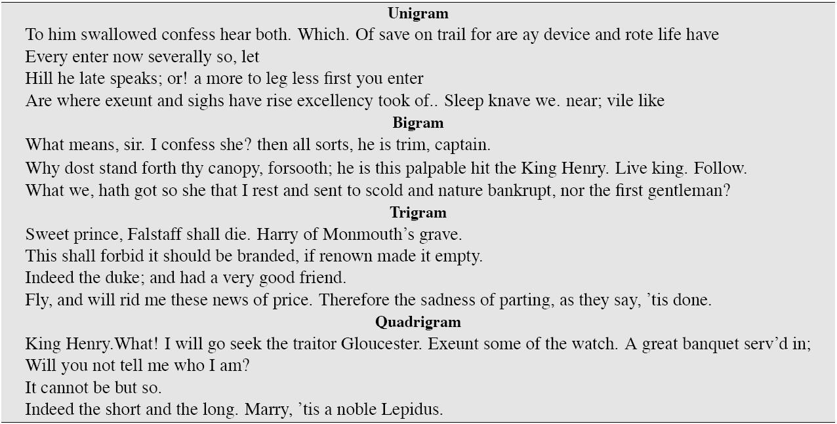
Approximating Shakespeare
Dan Jurafsky
Notes:
Using ngrams trained it on shakepeare data
And generated data

Slide 44
Shakespeare as corpus
Dan Jurafsky
N=884,647 tokens, V=29,066
Shakespeare produced 300,000 bigram types out of V²= 844 million possible bigrams.
So 99.96% of the possible bigrams were never seen (have zero entries in the table)
Quadrigrams worse: What's coming out looks like Shakespeare because it is Shakespeare
Notes:
You built a word to word matrix… some are filled and a lot of those bigrams/combinations were 0’s

Slide 45
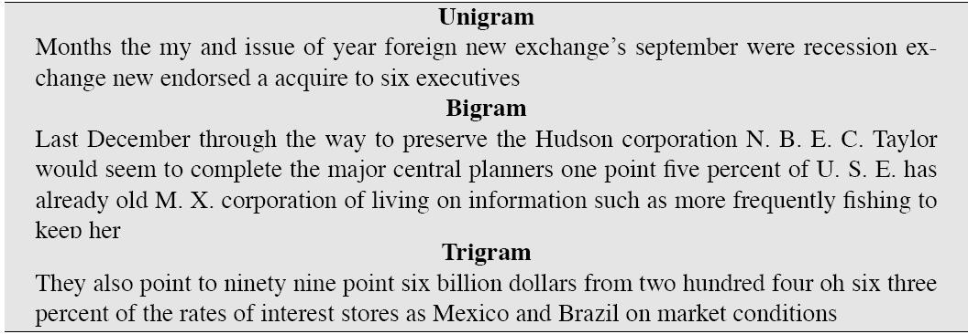
The wall street journal is not shakespeare (no oﬀense)
Dan Jurafsky

Slide 46
The perils of overﬁtting
Dan Jurafsky
N-­‐grams only work well for word prediction if the test corpus looks like the training corpus
In real life, it often doesn’t
We need to train robust models that generalize!
One kind of generalization: Zeros!
Things that don’t ever occur in the training set
But occur in the test set

Slide 47
Zeros
Dan Jurafsky
Training set:
… denied the allegations
… denied the reports
… denied the claims
… denied the request
Test set
… denied the oﬀer
… denied the loan
P(“oﬀer” | denied the) = 0

Slide 48
Zero probability bigrams
Dan Jurafsky
Bigrams with zero probability
mean that we will assign 0 probability to the test set!
And hence we cannot compute perplexity (can’t divide by 0)!
Notes:
What if a new word comes in testing?
What if a new bigram comes in test that didn’t occur in train?

Slide 49
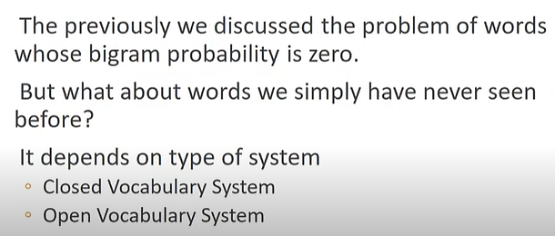
Unknown words: Open versus closed vocabulary tasks
Dan Jurafsky
Notes:
Unknown words that didn’t occur in the training set
Closed: define a list of words as your vocab
Open: 1)Define a threshold and those with frequency less then 2 mark them UNK
2)Keep most frequent 50k words in Vocab and mark others as UNK

Slide 50
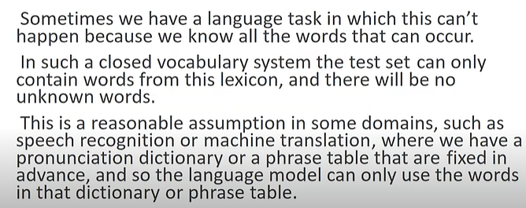
Closed vocabulary System
Dan Jurafsky
Notes:
Fixed vocab, fixed dictionary so no chances of unknown words in testing data
Lexicon: dictionary/ list of words

Slide 51
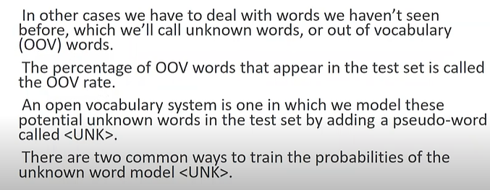
Open Vocabulary System
Dan Jurafsky
Notes:
U get unknown new words in test set
How many OOV words u have in the testing corpus: OOV rate

Slide 52
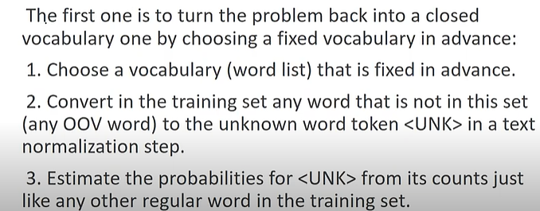
Open Vocabulary System: First Approach
Dan Jurafsky
Notes:
Fix the vocab, and convert words not in the list as UNK
U can get unknown words in test, so when u make UNK in train it will calculate probabilities for UNK as usual word in a corpus
How many OOV words u have in the testing corpus: OOV rate

Slide 53
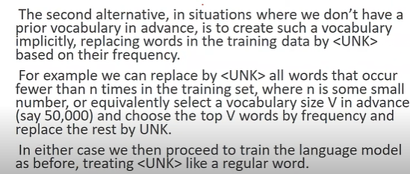
Open Vocabulary System: Second Approach
Dan Jurafsky
Notes:
1)Define a threshold and those with frequency less then 2 mark them UNK
2)Keep most frequent 50k words in Vocab and mark others as UNK

Slide 54
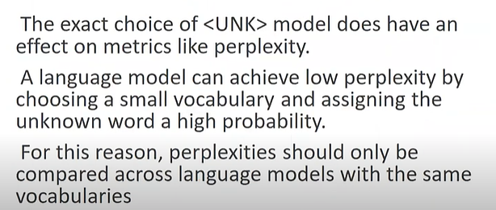
Unknown Words
Dan Jurafsky
Notes:
OOV rate should be kept low orherwise there will be issue where UNK might have a high prob and u may assume that mode is really good,
Now UNK can have a

Slide 55
Unknown words: Open versus closed vocabulary tasks
Dan Jurafsky
If we know all the words in advanced
Vocabulary V is fixed
Closed vocabulary task
Often we don’t know this
Out Of Vocabulary = OOV words
Open vocabulary task
Instead: create an unknown word token <UNK>
Training of <UNK> probabilities
Create a fixed lexicon L of size V
At text normalization phase, any training word not in L changed to <UNK>
Now we train its probabilities like a normal word
At decoding time
If text input: Use UNK probabilities for any word not in training

Slide 56
Language Modeling
Generalization and zeros

Slide 57
Language Modeling
Smoothing:
Add-­‐one (Laplace) smoothing
Notes:
When uve such bigrams that havnt occurred in the training set, how to deal with such a scenario. Handling problem of zeros..

Slide 58
The intuition of smoothing (from Dan Klein)
Dan Jurafsky
When we have sparse statistics:
P(w | denied the) 3 allegations
2 reports
1 claims
1 request
7 total
Steal probability mass to generalize better
P(w | denied the)
2.5 allegations
1.5 reports
0.5 claims
0.5 request
2 other
7 total
allegations
reports
attack
man outcome
request
…
claims
s
n
o
ti
a
g
e
l
l
a
allegations
outcome
reports
attack
man
…
claims
request
Notes:
When uve such bigrams that havnt occurred in the training set, how to deal with such a scenario. Handling problem of zeros..
Smoothing the probabilities

Slide 59
Add-­‐one estimation
Dan Jurafsky
Also called Laplace smoothing
Pretend we saw each word one more time than we did
Just add one to all the counts!
₎ ₌ c(w_{i−1}, w_{i} )
^{P}MLE ^{(w}i ^{| w}i−1
MLE estimate:
c(w )
i−1
₎ ₌ c(w_{i−1}, w_{i} ) +1
P (w | w
Add-­‐1 estimate:
Add−1 i
i−1
c(w ) + V
i−1
Notes:
MLE: maximum likelihood estimation
<s> I do not like SAM </s>

Slide 60
Maximum Likelihood Estimates
Dan Jurafsky
The maximum likelihood estimate
of some parameter of a model M from a training set T
maximizes the likelihood of the training set T given the model M
Suppose the word “bagel” occurs 400 times in a corpus of a million words
What is the probability that a random word from some other text will be “bagel”?
MLE estimate is 400/1,000,000 = .0004
This may be a bad estimate for some other corpus
But it is the estimate that makes it most likely that “bagel” will occur 400 times in a million word corpus.

Slide 61
Raw bigram counts
Dan Jurafsky
Out of 9222 sentences
Notes:
Make a matrix of term to term, unique terms
2. also calculate frequency of each term individually as well
Make a matrix of unique terms
i k bd want kitni baar aya? This is what each term to term represents
It represents bigram, the count represents the frerquency of term to term

Slide 62
Raw bigram probabilities
Dan Jurafsky
Normalize by unigrams:
Result:
Notes:
P(i)= count (I)/ total count of i = 5/2533=0.002
P(want| I )= count (I want)/Count ( I )= 827/2533
Now if u have to compute probab of a sentence “<s>sam I do </s>”

Slide 63
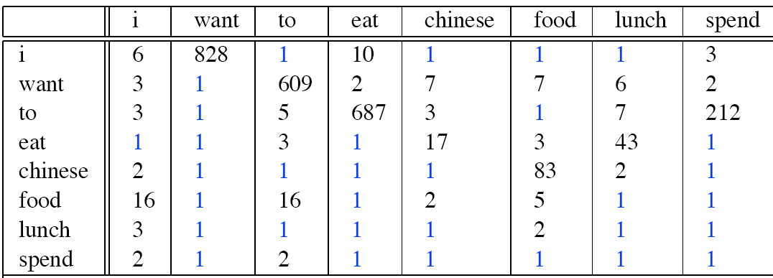
Berkeley Restaurant Corpus: Laplace smoothed bigram counts
Dan Jurafsky
Notes:
Count (I want)/count (i)
827/2533= 0.32

Slide 64

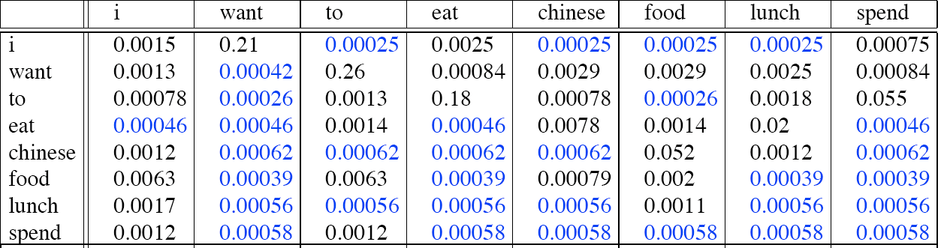
Laplace-smoothed bigrams
Dan Jurafsky
P* (want | i )= count (i want) + 1/count (i) + V
827+1/ 2533 + 1446=0.2081=0.21 (round of)
Notes:
Prob(want | i )= count (i want)/count (i)
Perplexity (Laplace)(want | i )= count (i want) + 1/count (i) + V
PP= 827+1/ 2533 + 1446=0.2081=0.21 (round of)
Prob of want changed from 0.33 to 0.21, so it means the count will also be chnaged

Slide 65

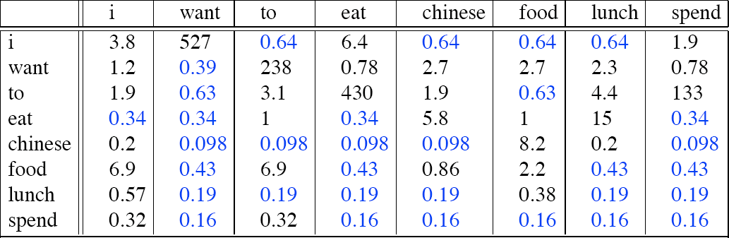
Reconstituted counts
Dan Jurafsky
Prob(want | i ) * count (i) = count (i want)
0.2081 * 2533 = 527
Notes:
Prob(want | i ) * count (i) = count (i want)
0.2081 * 2533 = 527

Slide 66
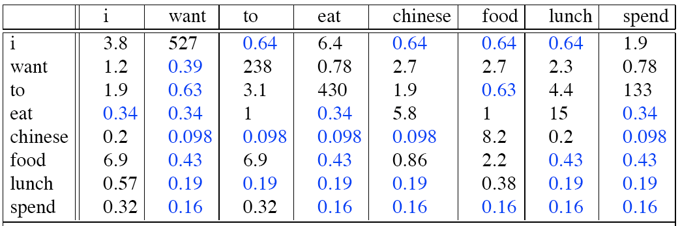
Compare with raw bigram counts
Dan Jurafsky
Notes:
Changes the distribution drastically, to smooth the zeroes it has also distorted the other counts
Moving prob mass of those that occur to those that do not occur
U remove value/counts from the observed and assign to those that did not occur (assigning 1 to 0s)
It will work where u ve less num of zeroes, so that distribution isn’t changed drastically.

Slide 67
Add-­‐1 estimation is a blunt instrument
Dan Jurafsky
So add-­1 isnt used for N-­‐grams:
We’ll see better methods
But add-­‐1 is used to smooth other NLP models
For text classification
In domains where the number of zeros isn’t so huge.

Slide 68
Language Modeling
Smoothing:
Add-­‐one (Laplace) smoothing

Slide 69
Language Modeling
Interpolation,
Backoﬀ, and Web-­‐Scale LMs

Slide 70
Backoff and Interpolation
Dan Jurafsky
Sometimes it helps to use less context
Condition on less context for contexts you haven’t learned much about
Backoﬀ:
Go to a lower order n-gram if the higher order n-gram count is unreliable or zero
use trigram if you have good evidence, otherwise bigram, otherwise unigram
The quick brown fox jumped over the lazy dog
P(dog| the lazy) if this trigram has an unreliable or zero value
P(dog|lazy) back off to a lower order n-gram
Notes:
Back off: when u go for n-grams and take a larger context u might have lesser count of w(i-2, i-3) etc
So, you back off and drop one cotext, if u were aiming for trigram, ull now go for bigram.

Slide 71
Interpolation
Dan Jurafsky
mix unigram, bigram, trigram
Add lambda with lower order n-gram and use it for prob estimate
Add lower order n-grams to the estimate of higher order n-grams
The quick brown fox jumped over the lazy dog
P(dog| the lazy) if this trigram has unreliable or zero value
P(dog| the lazy)= lambda P(dog| the lazy) + lambda P(dog|lazy) + lambda P(dog)
Lambda estimated on training corpus, learn with diff lambdas on training set
Evaluate on validation set (for which lambda perplexity is minimal: intrinsic evaluation)
Notes:
Adding lower order ngrams to the estimate of higher order ngrams– add a weighted estimate of lower order ngram
Parameter lambda >0, Learn with diff lambdas on training set
Evaluate on validation set (for which lambda perplexity is minimal: intrinsic evaluation)

Slide 72
Interpolation
Dan Jurafsky
The basic idea is to interpolate between higher-order n-gram models that have lower frequency and lower-order n-gram models that have higher frequency.
Notes:
Adding lower order ngrams to the estimate of higher order ngrams– add a weighted estimate of lower order ngram
Parameter lambda >0, Learn with diff lambdas on training set
Evaluate on validation set (for which lambda perplexity is minimal: intrinsic evaluation)

Slide 73
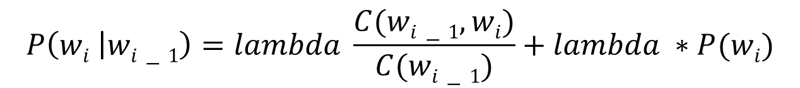
Linear Interpolation
Dan Jurafsky
Simple interpolation
$$P\left(wi | wi−1\right)=lambda \frac{C(wi−1, wi)}{C(wi−1)}+lambda ∗P(wi)$$
Add a weighted estimate of a lower order n-gram
Can be done recursively (trigram, bigram, unigram)
Lambda estimated on training corpus
Stupid Backoff
Notes:
Adding lower order ngrams to the estimate of higher order ngrams– add a weighted estimate of lower order ngram
Parameter lambda >0, Learn with diff lambdas on training set
Evaluate on validation set (for which lambda perplexity is minimal: intrinsic evaluation)

Slide 74
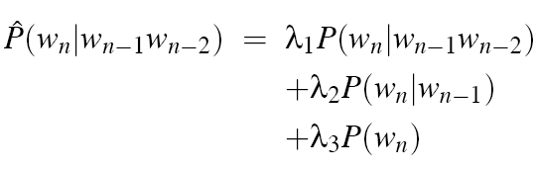

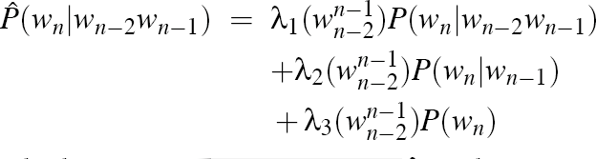
Linear Interpolation
Dan Jurafsky
Simple interpolation
Lambdas conditional on context:
Notes:
Adding lower order ngrams to the estimate of higher order ngrams– add a weighted estimate of lower order ngram
Parameter lambda >0, Learn with diff lambdas on training set
Evaluate on validation set (for which lambda perplexity is minimal: intrinsic evaluation)

Slide 75





How to set the lambdas?
Dan Jurafsky
Use a held-­‐out corpus
Training Data
Held-­‐Out Data
Test Data
Choose λs to maximize the probability of held-­‐out data:
Fix the N-­‐gram probabilities (on the training data)
Then search for λs that give largest probability to held-­‐out set:
log P(w₁...w_{n} | M (λ₁...λ_{k} )) = ∑log P_{M (λ1...λk )} (w_{i} | w_{i−1} )
i

Slide 76
Stupid Backoff
Dan Jurafsky
The quick brown fox jumped over the lazy dog
P("dog" | "the lazy") = lambda * P("dog" | "lazy") + (1 - lambda) * P("dog")
where lambda is a smoothing parameter, typically set to 0.4 or 0.5.
Lambda is fixed, based on empirical analysis
Reduce the estimate of a lower n-gram to get a better estimate of a higher order n-gram
Stupid backoff produces scores rather than probabilities. And this works quite well for large scale N-Grams.
Notes:
Back off: when u go for n-grams and take a larger context u might have lesser count of w(i-2, i-3) etc
So, you back off and drop one cotext, if u were aiming for trigram, ull now go for bigram.

Slide 77
Smoothing for Web-­‐scale N-­‐grams
Dan Jurafsky
“Stupid backoﬀ” (Brants et al. 2007)
No discounting, just use relative frequencies
⎧
count(w^{i} )
i−k+1
if count(w^{i} ) > 0
S(w | w^{i−1}
) = ⎨
⎮
⎮⎩
count(w^{i−1} )
i−k+1
i
i−k+1
i−k+1
0.4S(w | w^{i−1} )
i i−k+2
otherwise
count(w )
S(w ) =
i
i
N
63

Slide 78
Huge web-­‐scale n-­‐grams
Dan Jurafsky
How to deal with, e.g., Google N-­‐gram corpus
Pruning
Only store N-­‐grams with count > threshold.
Remove singletons (lower order ngrams) of higher-­‐order n-­‐grams
Entropy-­‐based pruning
Efficiency
Efficient data structures
Store words as indexes, not strings
Use Huﬀman coding to fit large numbers of words into two bytes
Quantize probabilities (4-­‐8 bits instead of 8-­‐byte ﬂoat)
Notes:
If a bigram has a value greater then a threshold, then we do not keep its unigram (lower order ngrams)

Slide 79
N-­‐gram Smoothing Summary
Dan Jurafsky
Add-­‐1 smoothing:
OK for text categorization, not for language modeling
The most commonly used method:
Extended Interpolated Kneser-­‐Ney
For very large N-­‐grams like the Web:
Stupid backoﬀ
64

Slide 80
Advanced Language Modeling
Dan Jurafsky
Discriminative models:
choose n-­‐gram weights to improve a task, not to fit the training set
Parsing-­‐based models
Caching Models
Recently used words are more likely to appear
_{) + (1− λ)} c(w ∈ history)
P_{CACHE} (w | history) = λP(w_{i} | w_{i−2} w_{i−1}
| history |
These perform very poorly for speech recognition (why?)

Slide 81
Language Modeling
Interpolation,
Backoﬀ, and Web-­‐Scale LMs

Slide 82
Language Modeling
Advanced:
Good Turing Smoothing

Slide 83
Reminder: Add-1 (Laplace) Smoothing
Dan Jurafsky
₎ ₌ c(w_{i−1}, w_{i} ) +1
P (w | w
Add−1 i
i−1
c(w_{i−1} ) + V
Notes:
Instead of adding 1 for each ngram etc add k
K= 1 then it becomes add-1 smoothing

Slide 84
More general formulations: Add-k
Dan Jurafsky
₎ ₌ c(w_{i−1}, w_{i} ) + k
^{P}Add−k ^{(w}i ^{| w}i−1
c(w ) + kV
i−1
1
c(w_{i−1}, w_{i} ) + m( )
^{P}Add−k ^{(w}i ^{| w}i−1 ^{) = V}
c(w_{i−1} ) + m
Can you use k>1?
Notes:
Will K>1 be helpful in NLP? No now ur adding more than 1, so u usually go for lower values
If u add some low values it might not take too much from non zeroes to add up to zeroes
If all words have a uniform distribution 1/|V| is the probab estimate
M is used to modify it, so u add in the denominator to make sure normalization is correct

Slide 85
More general formulations: Add-k
Dan Jurafsky
1
c(w_{i−1}, w_{i} ) + m( )
^{P}Add−k ^{(w}i ^{| w}i−1 ^{) = V}
c(w_{i−1} ) + m
If all words occur uniformly, probability for words: 1/|v|
P(word)= 1/|V|
m>0
V=10000
1/|V|=0.0001
For good estimation m < |V|
If m=10000, it becomes add-1 smoothing
Notes:
If all words have a uniform distribution 1/|V| is the probab estimate
M is used to modify it, so u add in the denominator to make sure normalization is correct
Instead of 1\V u can also use unigram of that word

Slide 86
Unigram prior smoothing
Dan Jurafsky
1
c(w_{i−1}, w_{i} ) + m( )
^{P}Add−k ^{(w}i ^{| w}i−1 ^{) = V}
c(w_{i−1} ) + m
₎ ₌ c(w_{i−1}, w_{i} ) + mP(w_{i} )
P
(w | w
UnigramPrior
i
i−1
c(w ) + m
i−1
Notes:
Instead of 1\V u can also use unigram of that word P(wi)

Slide 87
Advanced smoothing algorithms
Dan Jurafsky
Intuition used by many smoothing algorithms
Good-­‐Turing
Kneser-­‐Ney
Witten-­‐Bell
Use the count of things we’ve seen once
to help estimate the count of things we’ve never seen

Slide 88
Notation: N_{c} = Frequency of frequency c
Dan Jurafsky
N_{c} = the count of things we’ve seen c times
Sam I am I am Sam I do not eat
N₁ = 3
N₂ = 2
N₃ = 1
I | 3
sam | 2
am | 2
do | 1
not | 1
eat | 1
72
Notes:
N1=3: 3 events with 1 length
N2=2: two events with 2 length

Slide 89
Good-Turing smoothing intuition
Dan Jurafsky
You are fishing (a scenario from Josh Goodman), and caught:
10 carp, 3 perch, 2 whitefish, 1 trout, 1 salmon, 1 eel = 18 fish
How likely is it that next species is trout?
1/18
How likely is it that next species is new (i.e. catfish or bass)
Let’s use our estimate of things-­‐we-­‐saw-­‐once to estimate the new things.
3/18 (because N₁=3)
Assuming so, how likely is it that next species is trout?
Must be less than 1/18
How to estimate?
Notes:
Bass will be 0/18 since bass is OOV
So to handle 0s, we estimate things we saw once

Slide 90
Good Turing calculations
Dan Jurafsky
_{c* =} (c +1)N_{c+1}
_{P}*
(things with zero frequency) = ^{N1}
N
GT
N
c
Unseen (bass or catfish)
c = 0:
MLE p = 0/18 = 0
Seen once (trout)
c = 1
MLE p = 1/18
P* (unseen) = N /N = 3/18
GT 1
C*(trout) = 2 * N2/N1
= 2 * 1/3
= 2/3
P* (trout) = c*/N= 2/3 / 18 = 1/27
GT
Notes:
C N
0 2
1 3
2 1
3 1

Slide 91
Ney et al.’s Good Turing Intuition
Dan Jurafsky
H. Ney, U. Essen, and R. Kneser, 1995. On the estimation of 'small' probabilities by leaving-­‐one-­‐out. IEEE Trans. PAMI. 17:12,1202-­‐1212
Held-out words:
75

Slide 92
Dan Jurafsky
Training
Held out
Ney et al. Good Turing Intuition (slide from Dan Klein)
N₁ N₂ N₃ ^{N}3511
 | ^{N}4417
N₀ N₁ N₂ ^{N}3510
 | ^{N}4416
Intuition from leave-­‐one-­‐out validation
Take each of the c training words out in turn
c training sets of size c–1, held-­‐out of size 1
What fraction of held-­‐out words are unseen in training?
N₁/c
What fraction of held-­‐out words are seen k times in training?
(k+1)N_{k+1}/c
So in the future we expect (k+1)N_{k+1}/c of the words to be those with training count k
There are N_{k} words with training count k
Each should occur with probability:
. . . .
. . . .
(k+1)N_{k+1}/c/N_{k}
…or expected count: k* =
(k +1)N
k+1
N_{k}

Slide 93
Good-Turing complications
(slide from Dan Klein)
Dan Jurafsky
Problem: what about “the”? (say c=4417)
For small k, N_{k} > N_{k+1}
For large k, too jumpy, zeros wreck estimates
N
1
N₂
N
3
Simple Good-­‐Turing [Gale and Sampson]: replace empirical N_{k} with a best-­‐fit power law once counts get unreliable
The best-fit power law is a model that predicts the probability of an event based on its frequency, and it is chosen to fit the observed counts as closely as possible.
 | N₁
 |  |  | N₂
Notes:
For large values of C, values will bcm shaky so smooth them out by using power law

Slide 94
Resulting Good-Turing numbers
Dan Jurafsky
Count c | Good Turing c*
0 | .0000270
1 | 0.446
2 | 1.26
3 | 2.24
4 | 3.24
5 | 4.22
6 | 5.19
7 | 6.21
8 | 7.24
9 | 8.25
Numbers from Church and Gale (1991)
22 million words of AP Newswire
_{c* =} (c +1)N_{c+1}
N_{c}

Slide 95
Language Modeling
Advanced:
Good Turing Smoothing

Slide 96
Language Modeling
Advanced:
Kneser-Ney Smoothing

Slide 97
Resulting Good-Turing numbers
Dan Jurafsky
Count c | Good Turing c*
0 | .0000270
1 | 0.446
2 | 1.26
3 | 2.24
4 | 3.24
5 | 4.22
6 | 5.19
7 | 6.21
8 | 7.24
9 | 8.25
Numbers from Church and Gale (1991)
22 million words of AP Newswire
_{c* =} (c +1)N_{c+1}
N_{c}
It sure looks like c* = (c -­‐ .75)

Slide 98
Absolute Discounting
Dan Jurafsky
Save ourselves some time and just subtract 0.75 (or some d)!
discounted bigram
_{) = max(}c(w_{i−1}, w_{i} ) − d, 0)
^{P}AbsoluteDiscounting ^{(w}i ^{| w}i−1
c(w )
i−1
(Maybe keeping a couple extra values of d for counts 1 and 2)
d=0.75 for c>2, smaller d for c<2
P(Francisco|san)= (c(san francisco) – 0.75)/c(san)
Notes:
Reduction in counts is almost constant (absolute discounting)
Lambda calculated directly
Continuation probablity

Slide 99

Absolute Discounting Interpolation
Dan Jurafsky
Save ourselves some time and just subtract 0.75 (or some d)!
discounted bigram
Interpolation weight
₎ ₌ c(w_{i−1}, w_{i} ) − d _{+ λ(w}
^{P}AbsoluteDiscounting ^{(w}i ^{| w}i−1
)P(w)
unigram
c(w )
i−1
i−1
But should we really just use the regular unigram P(w)?
Use continuation probability
Because of discounting you can estimate lambda directly don’t need held out dataset for it
82
Notes:
2. Don’t use unigram use continuation probability
Lambda (san)= d* num of distinct words following san/c(san)

Slide 100
Kneser-Ney Smoothing I
Dan Jurafsky
Better estimate for probabilities of lower-­‐order unigrams!
Shannon game: I can’t see without my reading Francisco ?
“Francisco” is more common than “glasses”
… but “Francisco” always follows “San”
The unigram is useful exactly when we haven’t seen this bigram!
Instead of P(w): “How likely is w”
P_{continuation}(w): “How likely is w to appear as a novel continuation?
For each word, count the number of bigram types it completes
Every bigram type was a novel continuation the first time it was seen
^{P}CONTINUATION ^{(w) ∝}
{w_{i−1} : c(w_{i−1}, w) > 0}
Notes:
Continuation probability: probability based on the context for which san Francisco is a continuation
Francisco is a continuation of how many words?

Slide 101
Kneser-Ney Smoothing II
Dan Jurafsky
How many times does w appear as a novel continuation:
^{P}CONTINUATION ^{(w) ∝}
{w_{i−1} : c(w_{i−1}, w) > 0}
Normalized by the total number of word bigram types
{(w_{j−1}, w_{j} ) : c(w_{j−1}, w_{j} ) > 0}
{w_{i−1} : c(w_{i−1}, w) > 0}
Francisco is a continuation of how many words?
P
(w) =
CONTINUATION
{(w_{j−1}, w_{j} ) : c(w_{j−1}, w_{j} ) > 0}
Count of all non-zero bigrams
Notes:
Kitnay aur words hain jinke bd Francisco araha h

Slide 102
Kneser-Ney Smoothing III
Dan Jurafsky
Alternative metaphor: The number of # of word types seen to precede w
| {w_{i−1} : c(w_{i−1}, w) > 0} |
normalized by the # of words preceding all words:
{w_{i−1} : c(w_{i−1}, w) > 0}
^{P}CONTINUATION ^{(w) =}
∑{w '_{i−1} : c(w '_{i−1}, w ') > 0}
w '
A frequent word (Francisco) occurring in only one context (San) will have a low continuation probability

Slide 103
Kneser-Ney Smoothing IV
Dan Jurafsky
₎ ₌ max(c(w_{i−1}, w_{i} ) − d, 0) _{+ λ(w}
P (w | w
)P
(w )
KN
i
i−1
c(w )
i−1 CONTINUATION
i
i−1
λ is a normalizing constant; the probability mass we’ve discounted
d
λ(w_{i−1} ) = {w : c(w , w) > 0}
c(w )
i−1
i−1
The number of word types that can follow w_{i-1}
= # of word types we discounted
= # of times we applied normalized discount
the normalized discount
86
Notes:
Absolute discounted bigram +lambda*continuation probab

Slide 104
Kneser-Ney Smoothing: Recursive formulation
Dan Jurafsky
max(c (w^{i} ) − d, 0)
i−1
KN i−n+1
+ λ(w^{i−1} )P ^{i−1} )
i−n+1 KN ^{(w}i ^{| w}i−n+2
^{P}KN ^{(w}i ^{| w}i−n+1⁾ ⁼
_{(w}i−1
c
)
KN i−n+1
⎮⎧
count(•) for the highest order
c_{KN} (•) = ⎨
⎩⎮ continuationcount(•) for lower order
Continuation count = Number of unique single word contexts for •
87

Slide 105
Language Modeling
Advanced:
Kneser-Ney Smoothing

